Slide 1
2013/6/5 BELLA Magspec Camera Location Calibrations
Ver. 2
Kei

Slide 2
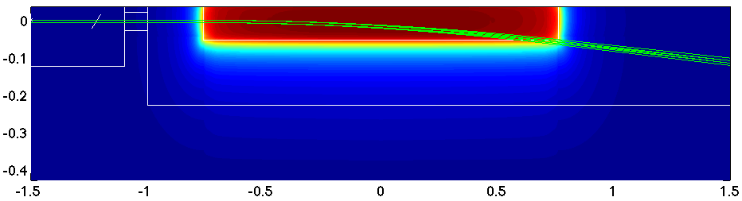
Screen and magnet locations: magnet 12.6m away from laser focus
-0.0361
0.2051
0.218
1.695
-0.89
0.864
0.927
1.665
Magnet center: 12.6 m from the laser focus (Z=0 -> 12.6)
See 120730Log for other landmarks.
View [mm] = 0.787 x Z [mm]+ 10.8 [mm]

Slide 3
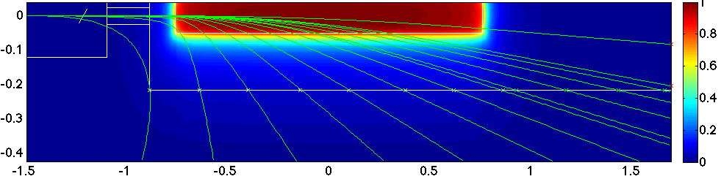
Quick momentum chart
pMevi=[9500,3450,3100,2600,2050,1575,1450,1075,730,440,245,100,25,2];

Slide 4
Camera C and G found less sensitive. Try swap.
CamG <-> CamL
CamC <-> CamK

Slide 5
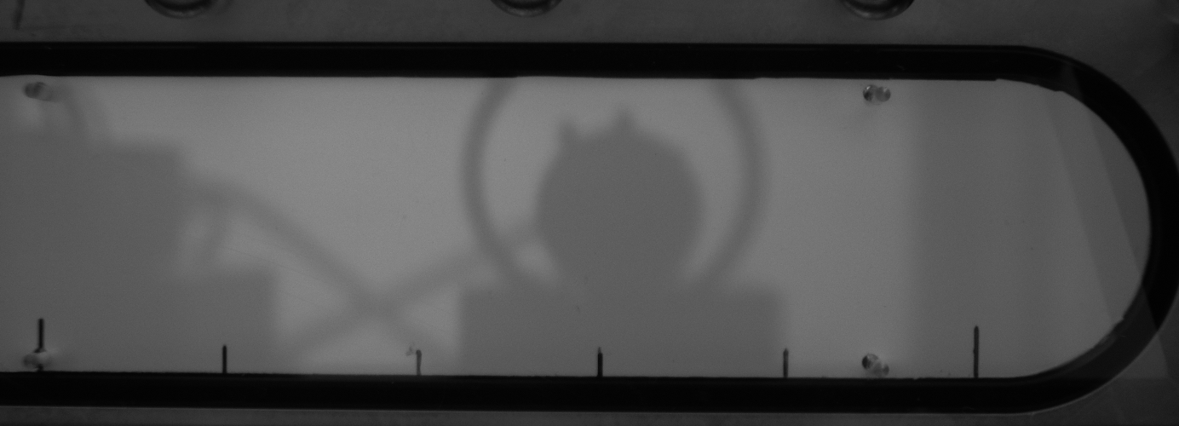
Front: Cam A (83 cam3)
48 pix
82.9 mm
9.5 GeV/cT
1144 pix
-17.1 mm
1352 pix
-36.1 mm
Resolution: 91u/pixel
Field of view = 126.3 mm, Z = 146.7 mm,
Range: -39.0 ~ 87.2 mm
ROI Y offset: 250, height: 500

Slide 6
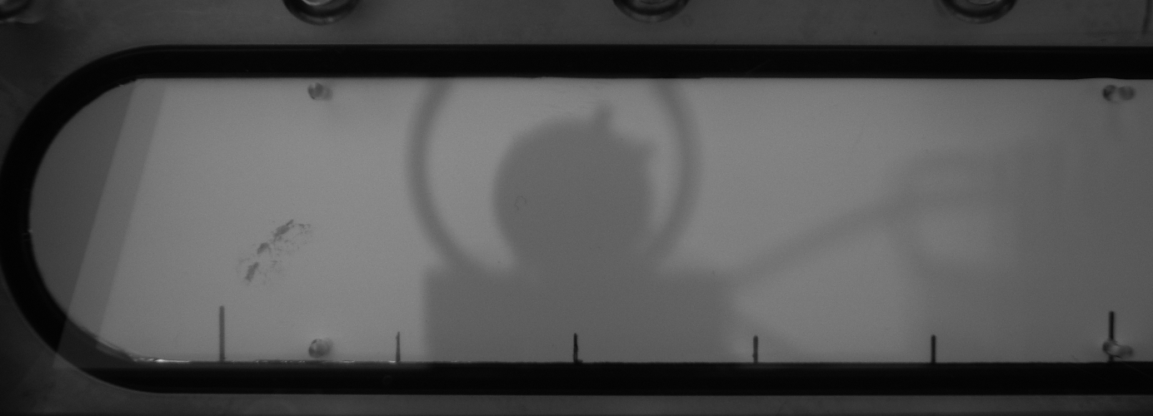
Front: Cam B (83 cam0)
29 pix
205.1 mm
3.45 GeV/cT
270 pix
182.9 mm
1334 pix
82.9 mm
9.5 GeV/cT
Resolution: 94u/pixel
Field of view = 130.1 mm, Z = 151.6 mm,
Range: 78.2 ~ 208.2 mm
ROI Y offset: 250, height: 500

Slide 7
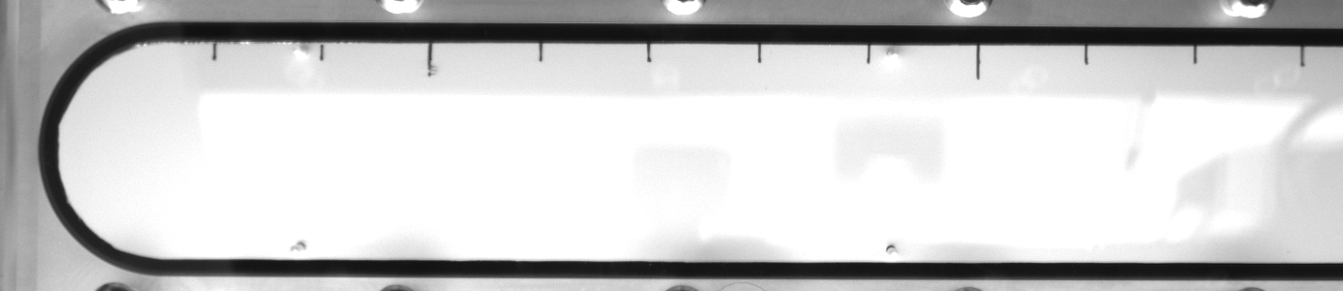
Side1: Cam C (83 cam2) 2016/6/13
58 pix
1665 mm
3.1 GeV/cT
1342 pix
1435.8 mm
2.6 GeV/cT
221 pix
1635.8 mm
Resolution: 178.2um/pixel
Field of view = 246.7 mm, Z = 299.8 mm,
Range: 1428.3 ~ 1675.0 mm
ROI Y offset: 350, height: 300

Slide 8
Side1: Cam C (83 cam2)
57 pix
1665 mm
3.1 GeV/cT
1343 pix
1435.8 mm
2.6 GeV/cT
222 pix
1635.8 mm
Resolution: 178.2um/pixel
Field of view = 246.7 mm, Z = 299.8 mm,
Range: 1428.5 ~ 1675.2 mm
ROI Y offset: 350, height: 300

Slide 9
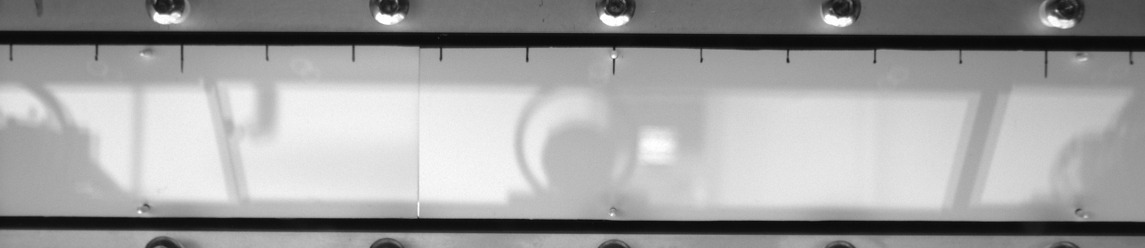
Side1: Cam D (83 cam1)
13 pix
1435.8 mm
2.6GeV/cT
1367 pix
1175.8 mm
2.05GeV/cT
Resolution: 192 u/pixel
Field of view = 265.8 mm, Z = 324.0 mm,
Range: 1172.6 ~ 1438.1 mm
ROI Y offset: 340, height: 300

Slide 10
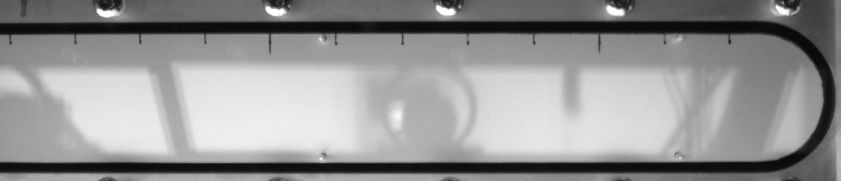
Side1: Cam E (71 cam2)
16 pix
1175.8 mm
2.05GeV/cT
1356 pix
926.9 mm
1.575GeV/cT
1200 pix
955.8 mm
Resolution: 186u/pixel
Field of view = 257.2 mm, Z = 313.0 mm,
Range: 921.7 ~ 1178.6 mm
ROI Y offset: 350, height: 300

Slide 11
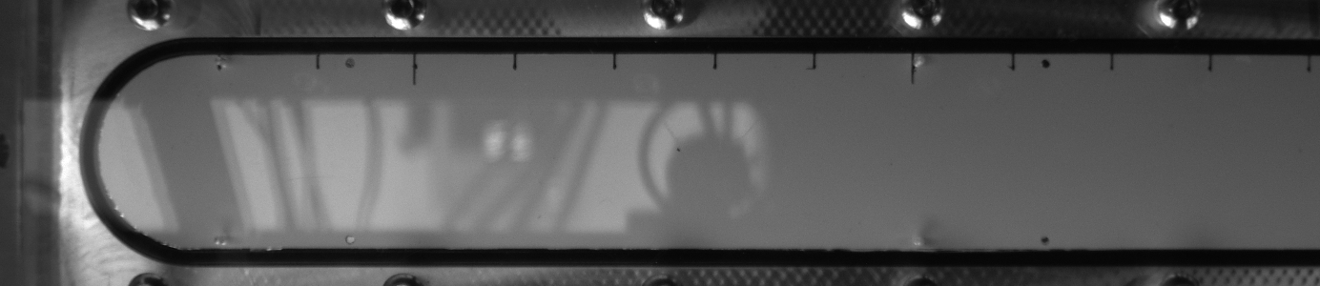
Side2: Cam F (71 cam1)
98 pix
864 mm
1.45GeV/cT
1373 pix
618.6 mm
1.075GeV/cT
230 pix
838.6 mm
Resolution: 192u/pixel
Field of view = 266.4 mm, Z = 324.8 mm,
Range: 616.5 ~ 882.7 mm
ROI Y offset: 330, height: 300

Slide 12
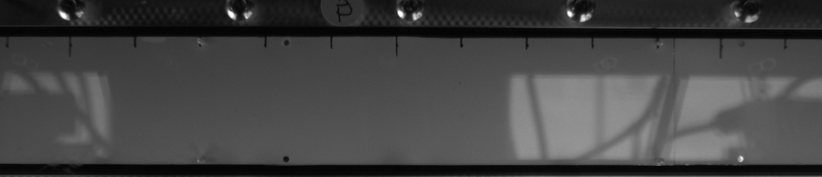
Side2: Cam G (71 cam0)
13 pix
618.6 mm
1.075GeV/cT
1323 pix
378.6 mm
0.73GeV/cT
Resolution: 183.2 u/pixel
Field of view = 253.6 mm, Z = 308.6 mm,
Range: 367.4 ~ 621.0 mm
ROI Y offset: 320, height: 300

Slide 13
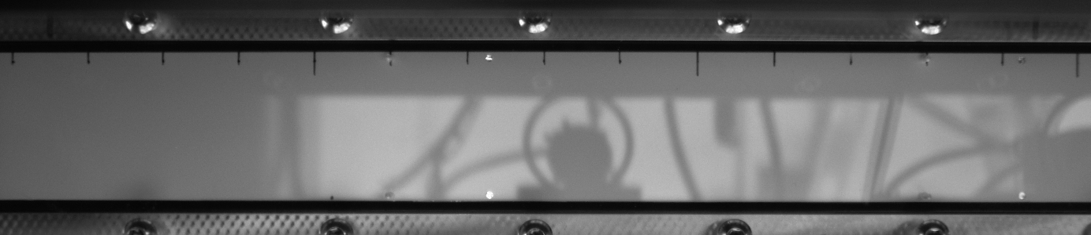
Side2: Cam H (71 cam3)
16 pix
378.6 mm
0.73GeV/cT
1367 pix
98.6 mm
0.44GeV/cT
Resolution: 207 u/pixel
Field of view = 286.8 mm, Z = 350.7 mm,
Range: 95.1 ~ 381.7 mm
ROI Y offset: 320, height: 300

Slide 14
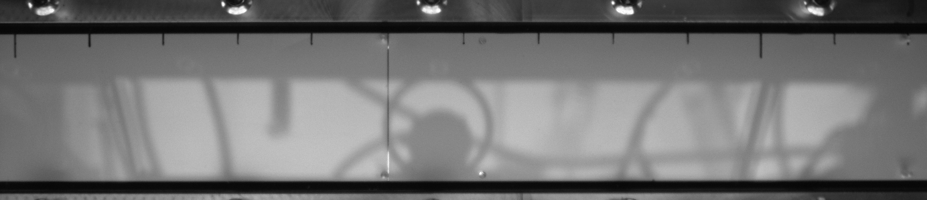
Side2: Cam I (82, cam0)
23 pix
98.6 mm
0.44GeV/cT
1356 pix
-141.4 mm
0.245GeV/cT
Resolution: 180 u/pixel
Field of view = 249.2 mm, Z = 302.9 mm,
Range: -146 ~ 102.6 mm
ROI Y offset: 320, height: 300

Slide 15
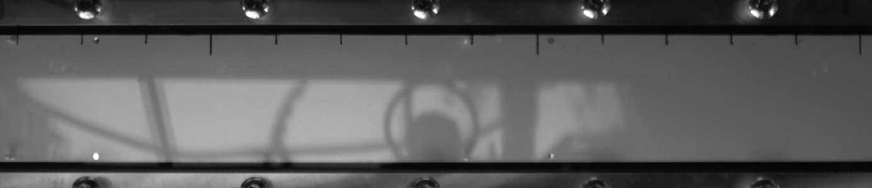
Side2: Cam J (82, cam1)
28 pix
-141.4 mm
0.245GeV/cT
1366 pix
-401.4 mm
0.1GeV/cT
Resolution: 194 u/pixel
Field of view = 268.9 mm, Z = 328.0 mm,
Range: -404.9 ~ -136.2 mm
ROI Y offset: 360, height: 300

Slide 16
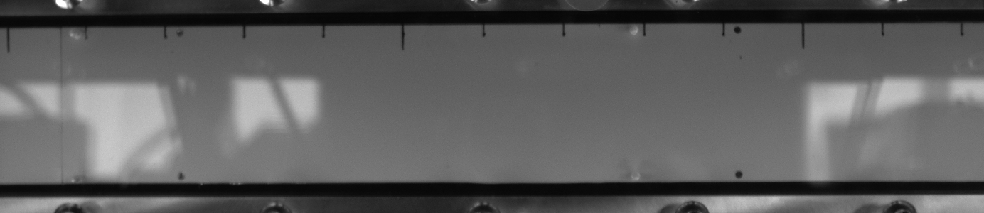
Side2: Cam K (82, cam3)
12 pix
-401.4 mm
0.1GeV/cT
1353 pix
-641.4 mm
25MeV/cT
Resolution: 179.0 u/pixel
Field of view = 247.7 mm, Z = 301.1 mm,
Range: -647.0 ~ -399.3 mm
ROI Y offset: 320, height: 300

Slide 17
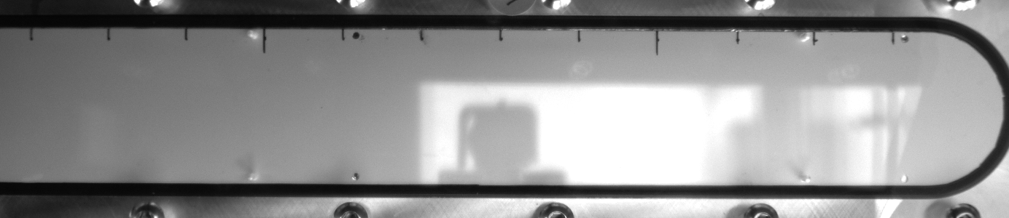
Side2: Cam L (82, cam2)
43 pix
-641.4 mm
25MeV/cT
1378 pix
-889.9 mm
2MeV/cT
1226 pix
-861.4 mm
Resolution: 186.1u/pixel
Field of view = 257.6 mm, Z = 313.8 mm,
Range: -891.0 ~ -633.4 mm
ROI Y offset: 310, height: 300

